Slide 1


Daniel Cowan
August 19, 2024

Slide 2

Outline
Executive Summary
Introduction
Methodology
Results
Conclusion
Appendix

Slide 3
Executive Summary
To better predict launch cost, we aim to predict whether the first stage of a launch will land successfully after launch
After fetching data, we use exploratory data analysis methods to review possible correlations in the data and explore trends
To make our predictions, we analyze the accuracy of four models: logistic regression, support vector machine, decision tree classifier, and k-nearest neighbors
Our analysis finds that all models perform similarly on this task, achieving about 83% accuracy in determining whether the first stage will land successfully

Slide 4
Introduction
Launch costs are heavily driven by whether the first stage of the launch can be recovered
If we can predict whether the first stage is likely to land successfully and therefore be recovered, we can more accurately estimate the launch cost
In this project, we aim to use SpaceX historical launch data to predict whether the first stage will land successfully
We can use the predictions further down the line to predict launch costs

Slide 5

Section 1

Slide 6
Methodology
Data collection methodology:
Data was collected from APIs and a Wikipedia table
Perform data wrangling
Categorical data was one-hot encoded, a binary target variable was created, null data replaced, and non-Falcon9 launches were filtered out
Perform exploratory data analysis (EDA) using visualization and SQL
Perform interactive visual analytics using Folium and Plotly Dash
Perform predictive analysis using classification models
Logistic regression, SVM, decision tree, and KNN tested

Slide 7
Data Collection
Data was collected from two main sources:
SpaceX APIs (calls using the requests library)
Retrieved rocket version, launch site, payload mass, and core launch data from various APIs
Wikipedia (scraping using BeautifulSoup)
Launch data, including launch and landing outcomes, scraped from Falcon9 Launches Wikipedia table

Slide 8
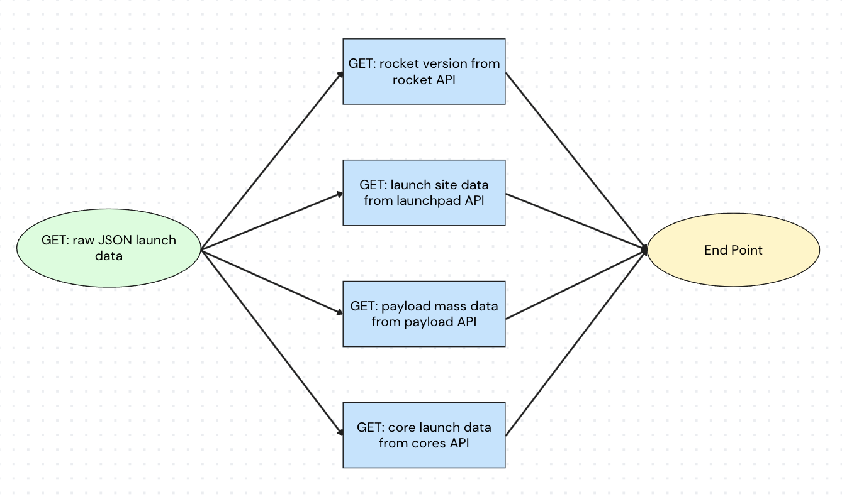
Data Collection – SpaceX API
As shown, data was collected from several APIs, and was prepped for visualization and modeling using data wrangling methods
https://github.com/dcstats/DSP-Cert/blob/main/Capstone/jupyter-labs-spacex-data-collection-api.ipynb

Slide 9
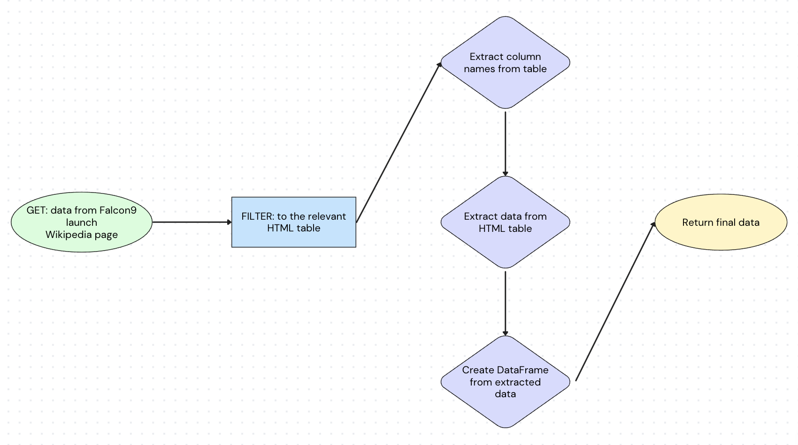
Data Collection - Scraping
Data was collected from the Falcon9 Launch Wikipedia page, and was prepped for visualization and modeling using BeautifulSoup and data wrangling methods
https://github.com/dcstats/DSP-Cert/blob/main/Capstone/jupyter-labs-webscraping.ipynb

Slide 10
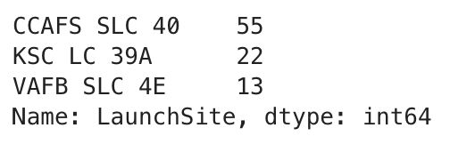
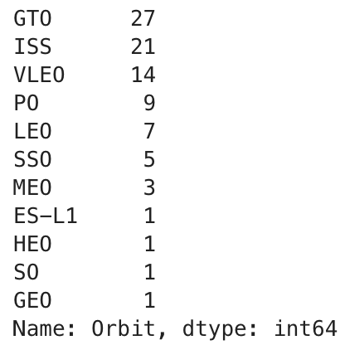
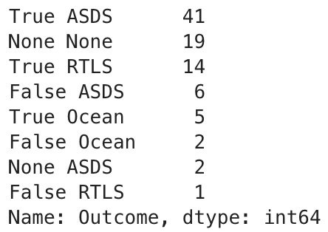
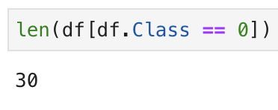
Data Wrangling
Number of launches per site
Number of launches for each orbit
Totals of each landing outcome
Create landing outcome label
https://github.com/dcstats/DSP-Cert/blob/main/Capstone/labs-jupyter-spacex-Data%20wrangling.ipynb

Slide 11
EDA with Data Visualization
Visualizations created:
Scatterplot: Flight number vs. launch site to review whether launch locations changed as time passed
Scatterplot: Payload mass vs launch site to review whether larger payloads were launched at certain locations
Bar chart: orbit vs. landing success rate to review whether launches into certain orbits had more landing success
Scatterplot: Flight number vs orbit to review whether types of orbits changed over time
Scatterplot: Payload mass vs orbit to review whether orbit was affected by mass of load
Line plot: Date vs landing success rate to review how success rate changed over time
Feature engineering: dummy variables for categorical features
https://github.com/dcstats/DSP-Cert/blob/main/Capstone/edadataviz.ipynb

Slide 12
EDA with SQL
EDA tasks include viewing:
1) Unique launch sites, 2) 5 records with launch sites starting with the string ‘CCA’, 3) total payload mass carried by customer NASA (CRS), 4) average payload mass carried by booster version ‘F9 v1.1’, 5) the date when the first successful ground pad landing was completed, 6) the names of the boosters carrying payload mass between 4,000 and 6,000 kg with successful drone ship landings, 7) the counts of each landing outcome, 8) the names of booster versions which have carried the maximum payload mass, 9) selected features for records in 2015 with failed drone ship landings, and 10) the ranked count of landing outcomes for records between June 4, 2010 and March 20, 2017
https://github.com/dcstats/DSP-Cert/blob/main/Capstone/jupyter-labs-eda-sql-coursera_sqllite.ipynb

Slide 13
Build an Interactive Map with Folium
For exploration purposes, including examining proximity of the launch sites to coasts, the following were visualized with Folium:
All launch sites marked with Markers
Landing success outcomes for each launch site with MarkerClusters
Distances from launch site to coast
Distances from launch site to highway
https://github.com/dcstats/DSP-Cert/blob/main/Capstone/lab_jupyter_launch_site_location.ipynb

Slide 14
Build a Dashboard with Plotly Dash
Pie Chart:
Proportion of successful landings by launch site
Proportion of landing outcomes (successful/unsuccessful) for a selected launch site
Scatter Plot
Payload mass vs landing outcome to examine whether the payload size of the launch affects whether the first stage is able to land successfully
https://github.com/dcstats/DSP-Cert/blob/main/Capstone/spacex_dash_app.py

Slide 15
Predictive Analysis (Classification)
Models built and evaluated:
Logistic regression
Support Vector Machine (SVM)
Decision Tree Classifier
K-Nearest Neighbors (KNN)
Models were trained on a training set and tested for accuracy score on a separate test set of data
https://github.com/dcstats/DSP-Cert/blob/main/Capstone/SpaceX_Machine%20Learning%20Prediction_Part_5.ipynb

Slide 16
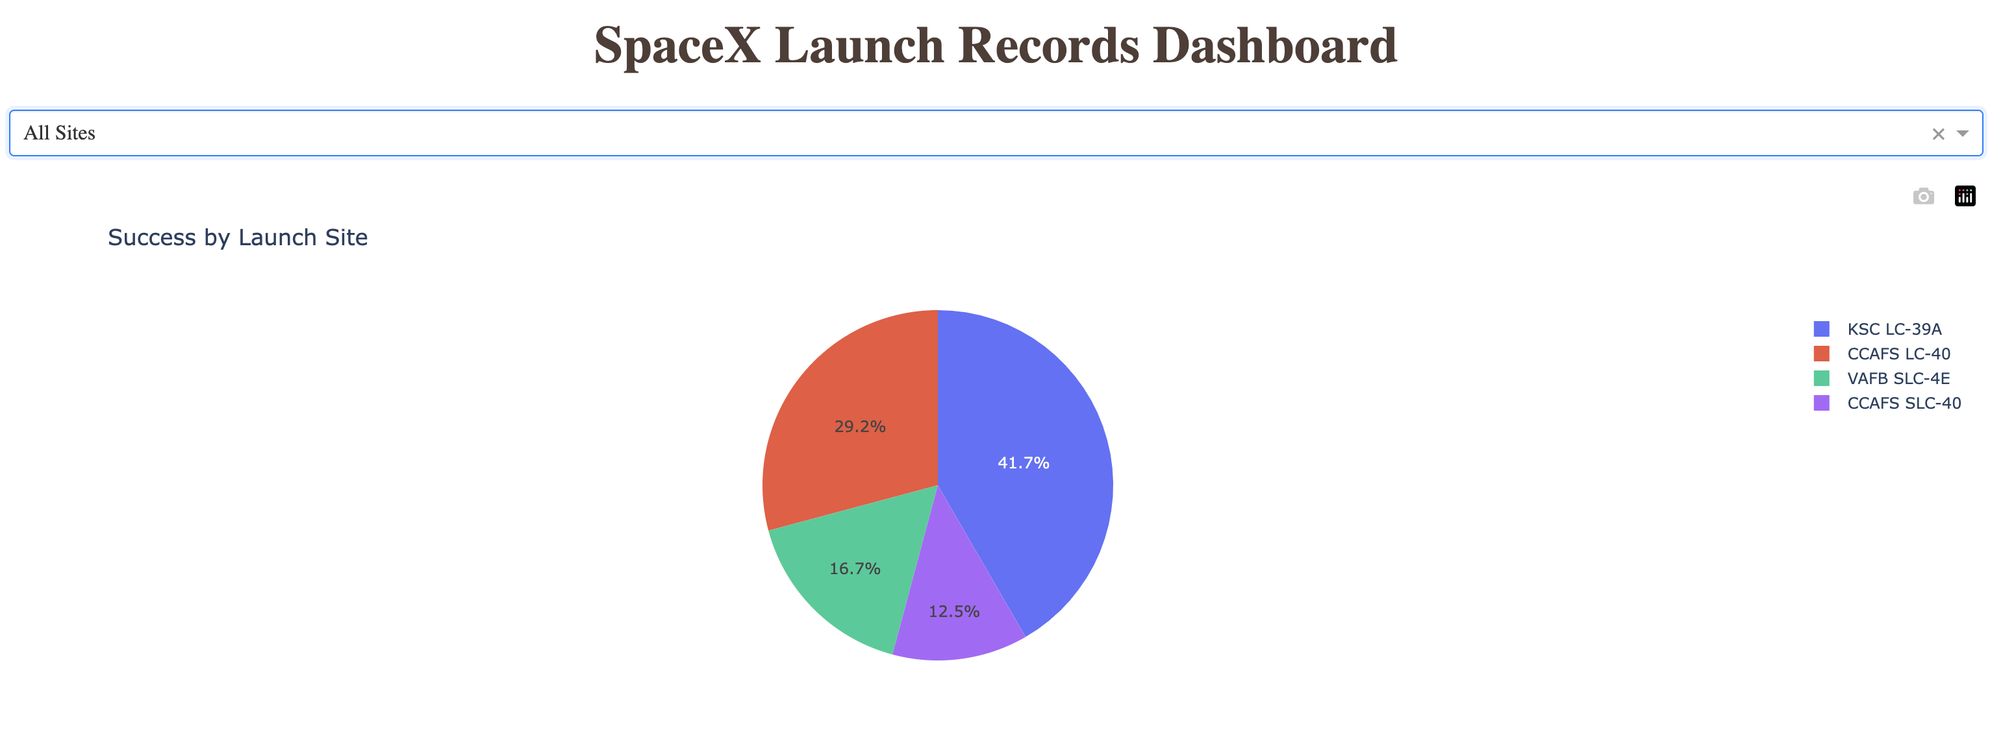
Results
EDA
Orbit type seems to have some effect on landing success
Landing success increased over time, likely due to improving infrastructure, which is not captured in the data
In data dating back to 2010, a ground pad landing was not achieved until 2015
Interactive analytics
Predictive analysis
The models all achieved the same test set accuracy, indicating:
The type of model is less important for achieving predictive accuracy
There might be an accuracy ceiling for the data we have available

Slide 17

Section 2

Slide 18
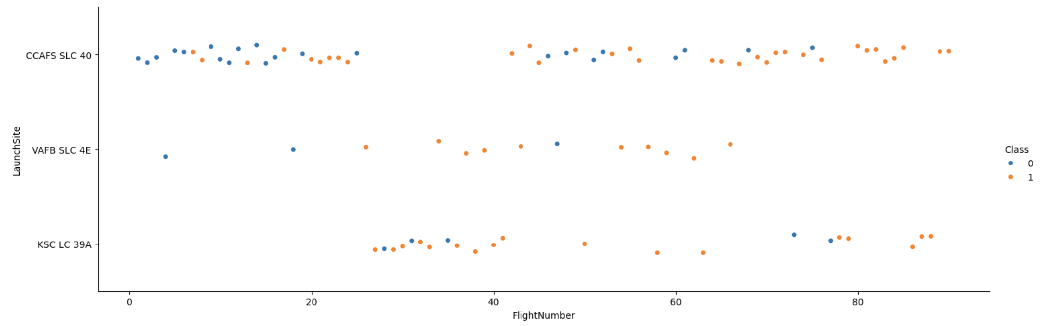
Flight Number vs. Launch Site
As time passed, it’s clear that landing success increased
Early on, launches were held at the CCAFS SLC 40 launch site, and landings there were generally unsuccessful

Slide 19
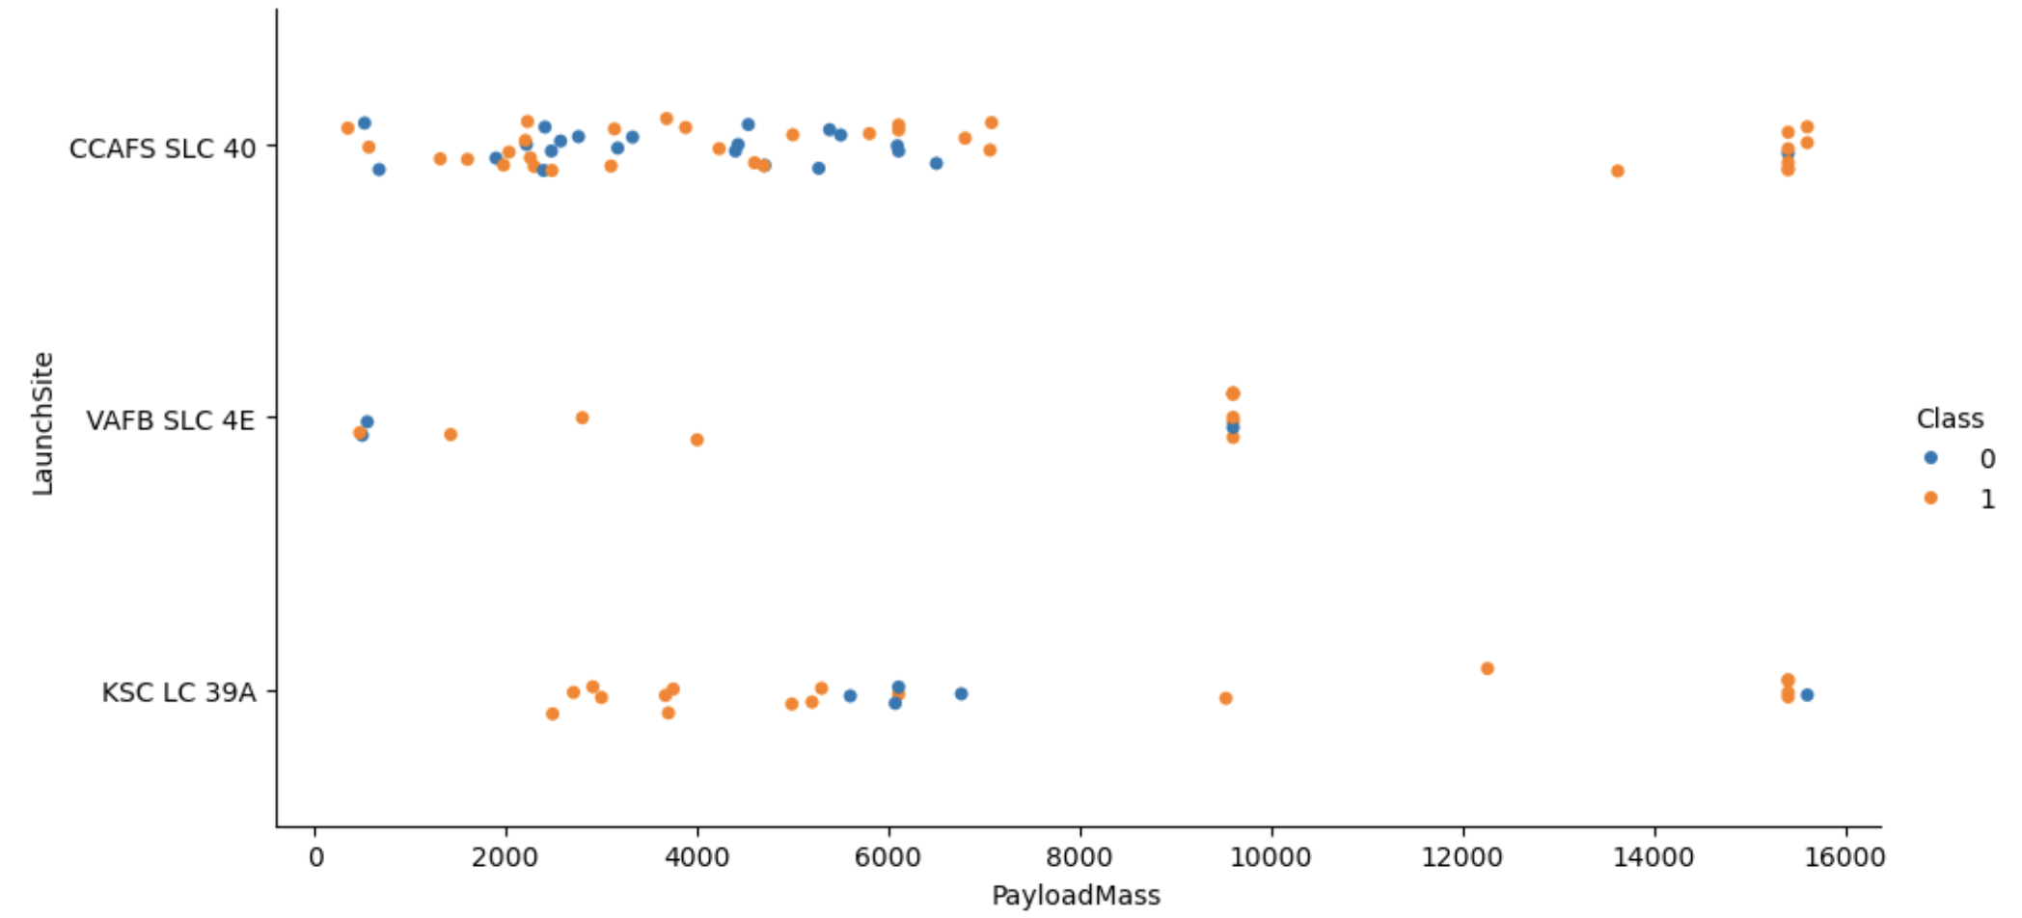
Payload vs. Launch Site
Most launches have smaller payload masses
In general, as payload size increases, so does landing success rate
This could be a bias,
as there is more incentive
to protect large payloads

Slide 20
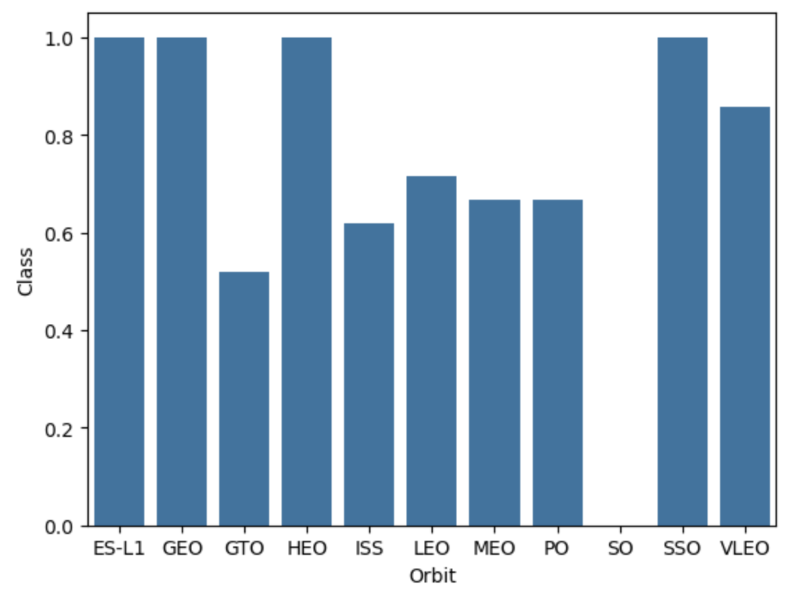
Success Rate vs. Orbit Type
SO orbits have yet to see a successful landing
ES-L1, GEO, HEO, and SSO orbits all have perfect landing success rates

Slide 21
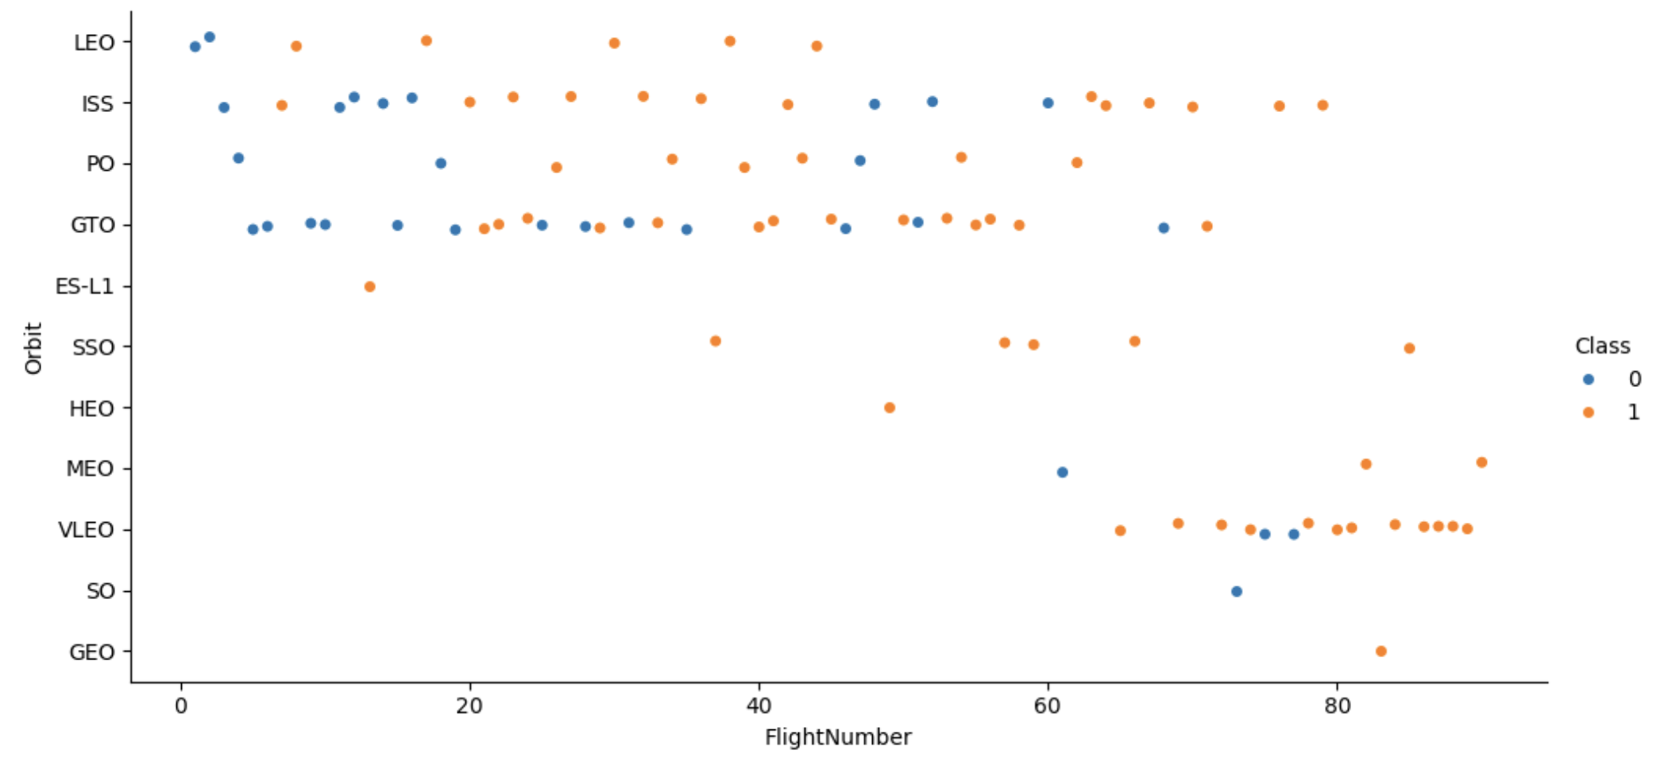
Flight Number vs. Orbit Type
As time increased, SpaceX switched to what are likely more complicated orbits; from LEO/ISS to VLEO/SSO
Most early flights had unsuccessful landings, but success increased with time

Slide 22
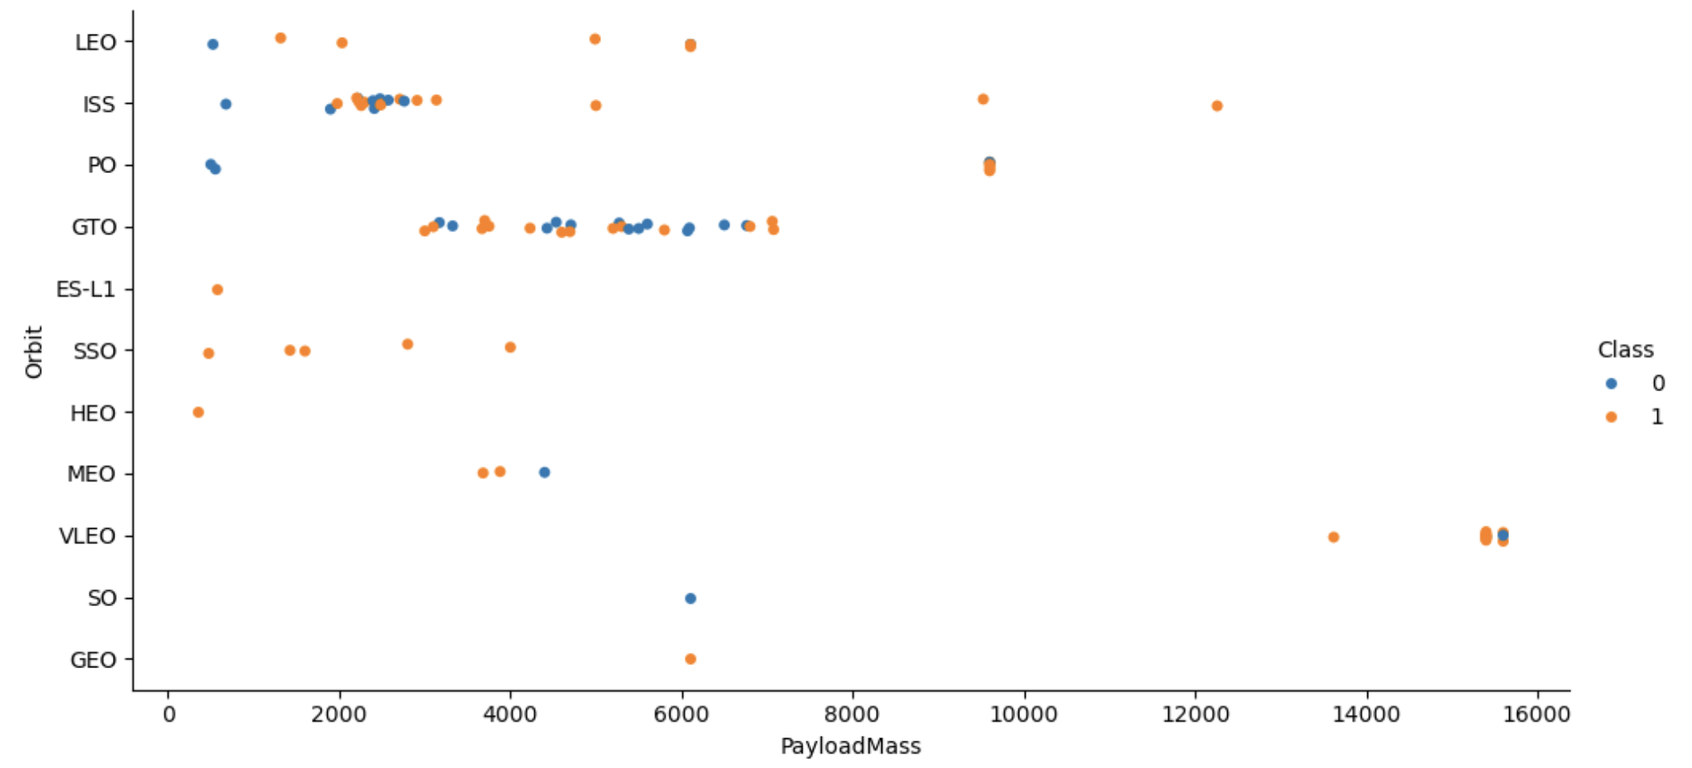
Payload vs. Orbit Type
Most launches have lower payload masses
VLEO orbits have the highest payloads; LEO and SSOs have among the lowest

Slide 23
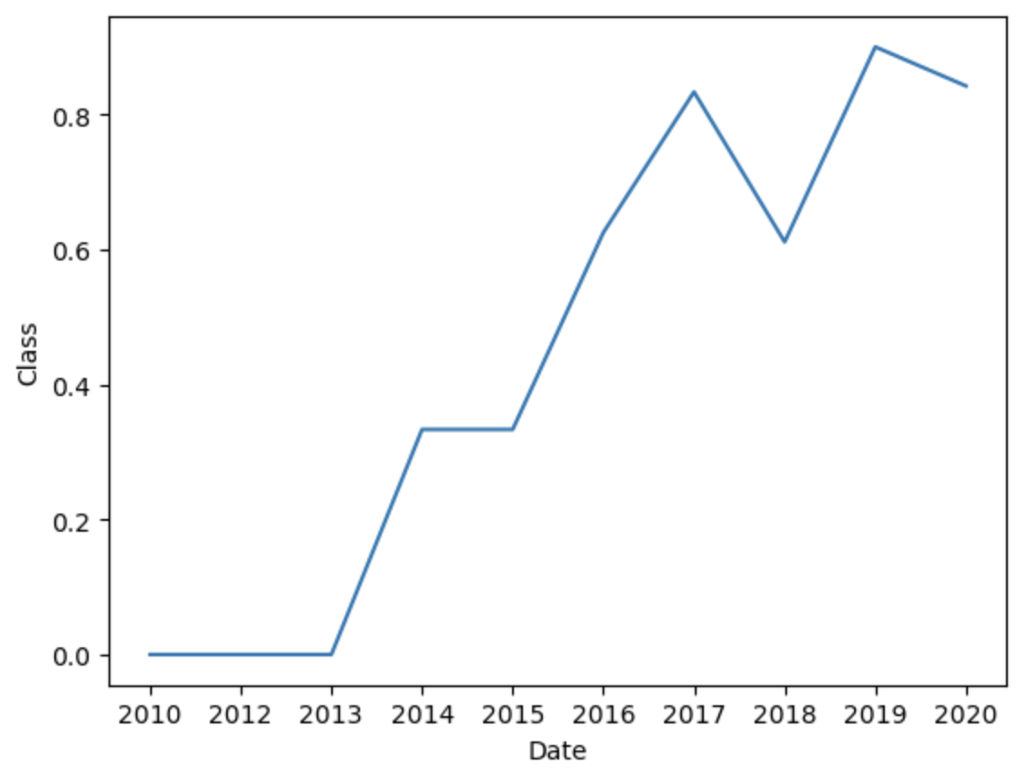
Landing Success Yearly Trend
Landing success clearly has increased over time
Innovations in landing technology clearly has had a positive effect on being able to land the first stage
Current success rates hover around 80%

Slide 24
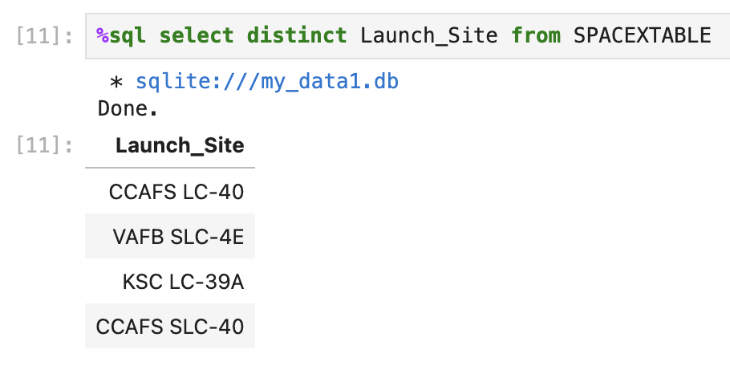
All Launch Site Names
Of the ~100 records, there are 4 unique launch sites

Slide 25
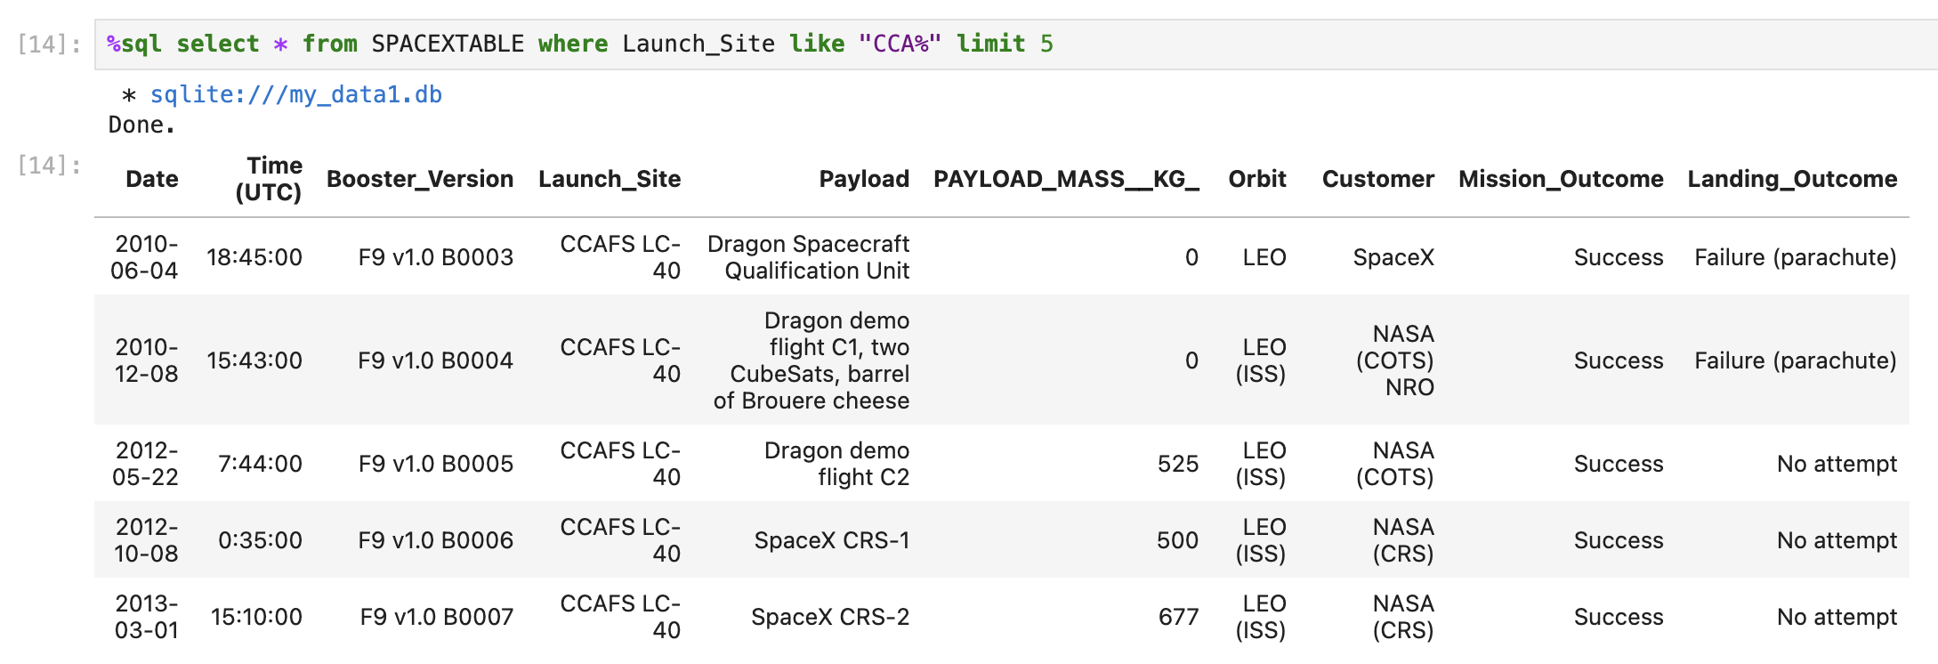
Launch Site Names Begin with 'CCA'
All 5 of the shown records are from launch site CCAFS LC-40
None of the shown launches ended in successful landing

Slide 26
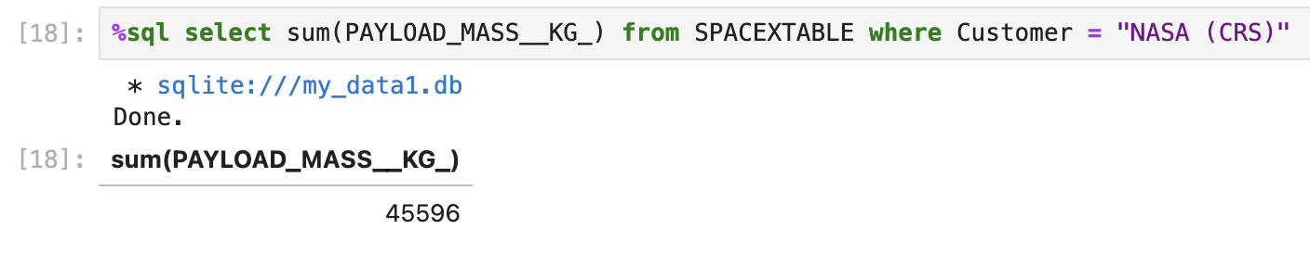
Total Payload Mass
NASA (CRS) carried a total payload mass of exactly 45,596 kg
Note that CRS is not the only program run by NASA that employed Space X’s services

Slide 27
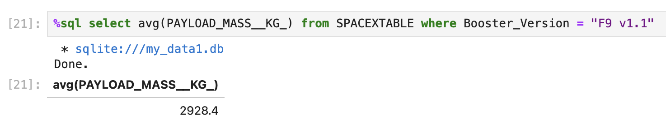
Average Payload Mass by F9 v1.1
Booster version F9 v1.1 carries an average payload of 2,928.4 kg

Slide 28
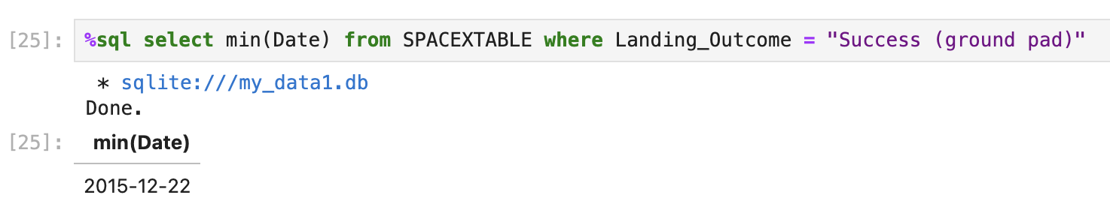
First Successful Ground Landing Date
The first successful ground pad landing was on December 22, 2015

Slide 29
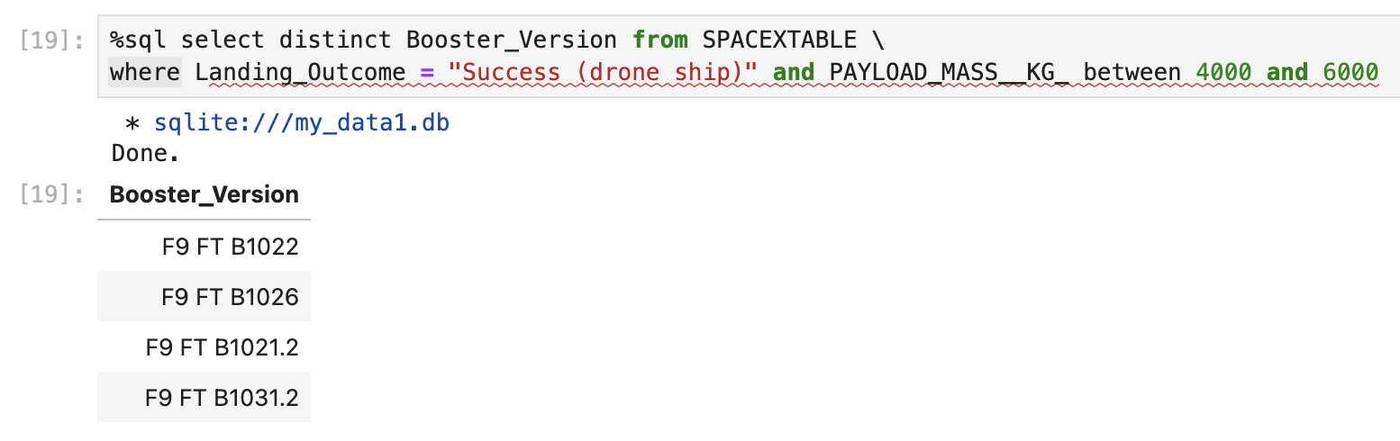
Successful Drone Ship Landing with Payload between 4000 and 6000
There are 4 boosters with payloads between 4,000 and 6,000 kg which had successful drone ship landings

Slide 30
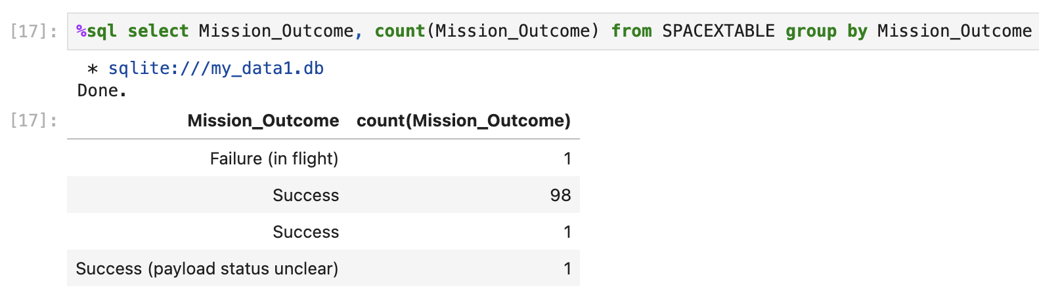
Total Number of Successful and Failure Mission Outcomes
All but 1 mission was listed as successful
Note that this is different from the landing outcome; far more landings were unsuccessful than missions

Slide 31
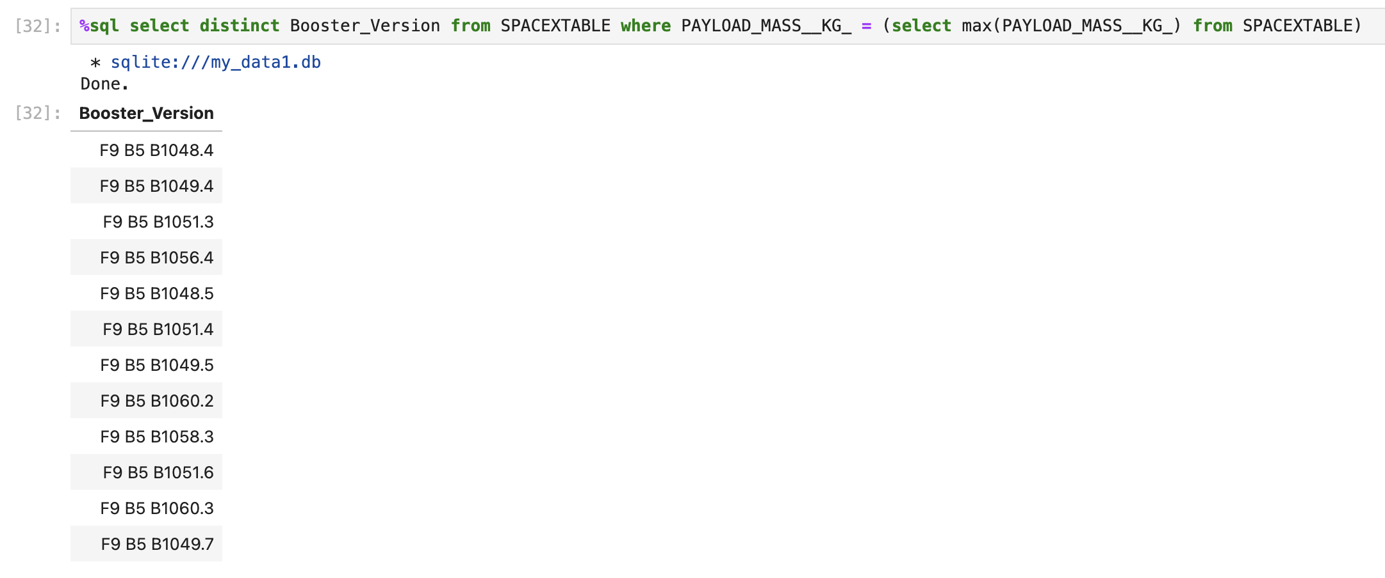
Boosters Carried Maximum Payload
A total of 12 unique boosters were able to carry the maximum payload
Note that only F9 B5 boosters were able to meet this criteria

Slide 32
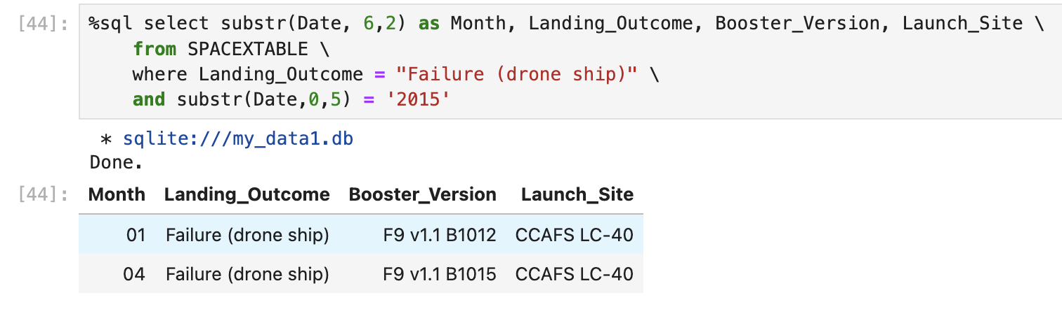
2015 Launch Records
There were just 2 failed drone ship landings in 2015; one in January and one in April
Both launched from the same site but used different boosters

Slide 33
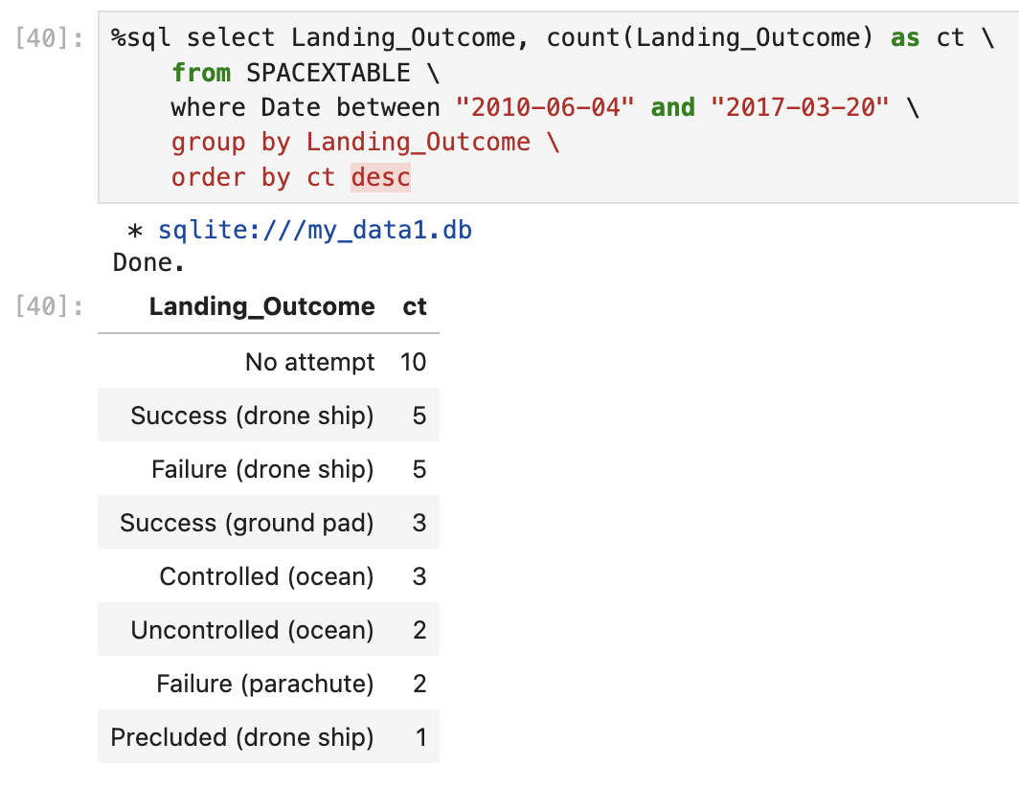
Rank Landing Outcomes Between 2010-06-04 and 2017-03-20
Most landings were not attempted at all; this is likely in the early years before technology to attempt landings was as advanced as it is now
Drone ship landing attempts followed in second

Slide 34

Section 3

Slide 35
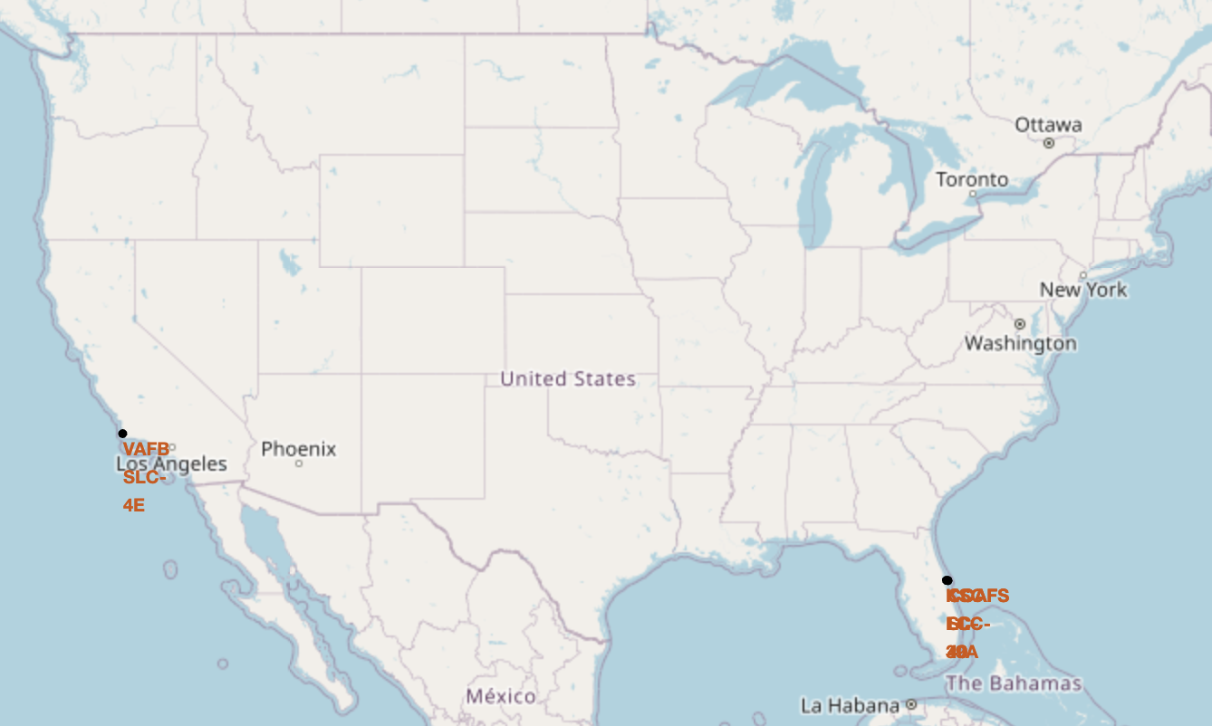
Launch Site Map
All launch sites are exclusively coastal
1 site in CA, 3 in FL

Slide 36
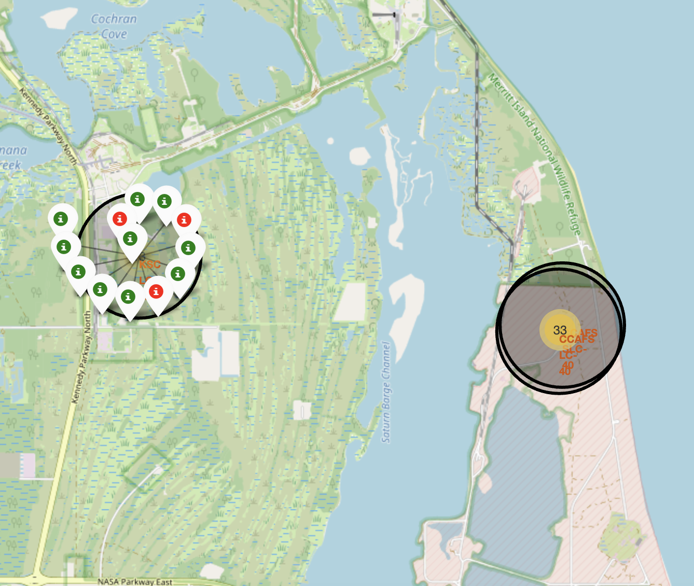
Launch Site Success
The more inland launch site appears to be more successful than the ones immediately on the coast
All other sites have <50% success rates

Slide 37
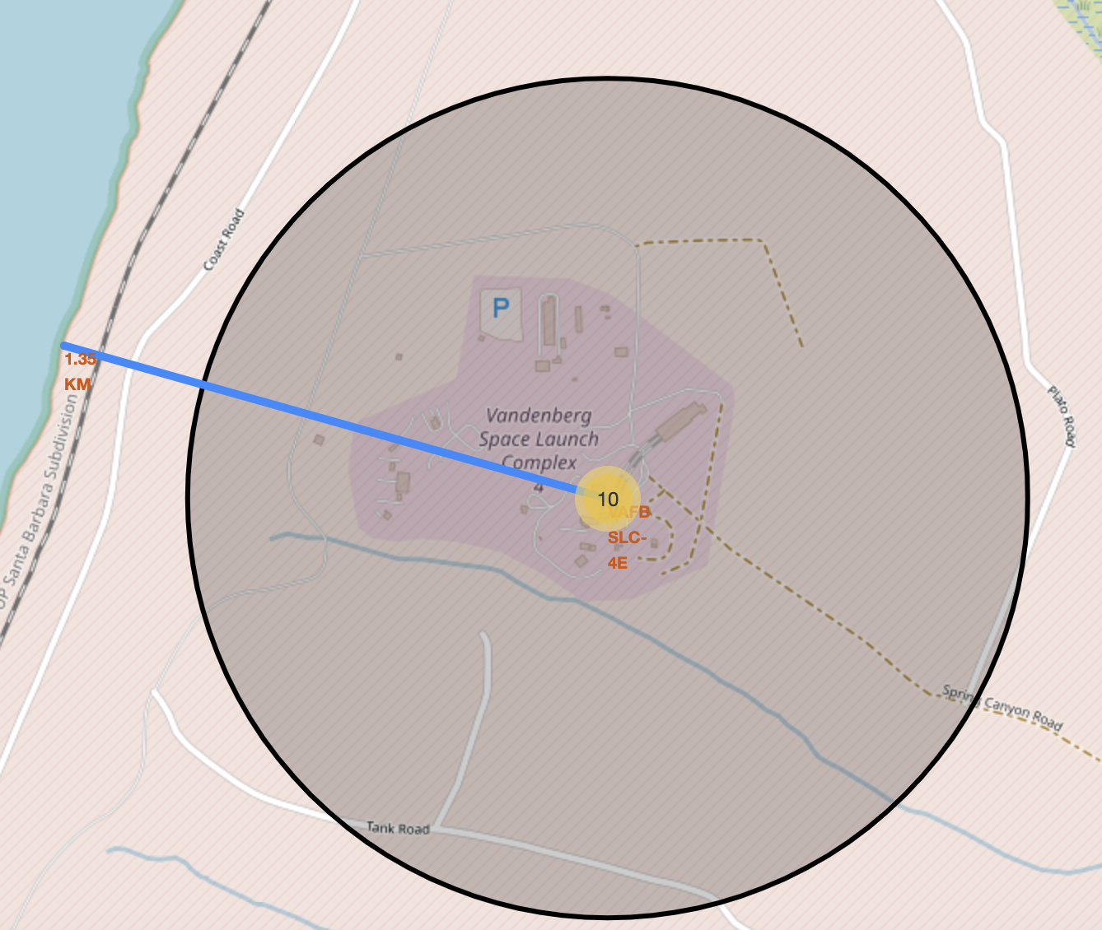
Launch Site Proximity to Shorelines
As seen here, this CA launch site is approximately 1.35km from the shore of the Pacific Ocean
This is a common theme with the four launch sites, as all 4 sites in the dataset are within 2 km of a shoreline
This makes sense; the ocean is the best way to avoid collateral damage in the case of a failed launch

Slide 38

Section 4

Slide 39
Launch Success by Launch Site
Launch site KSC LC-39A has the most successful launches, though it should be noted that this is not the same as having the highest success rate

Slide 40
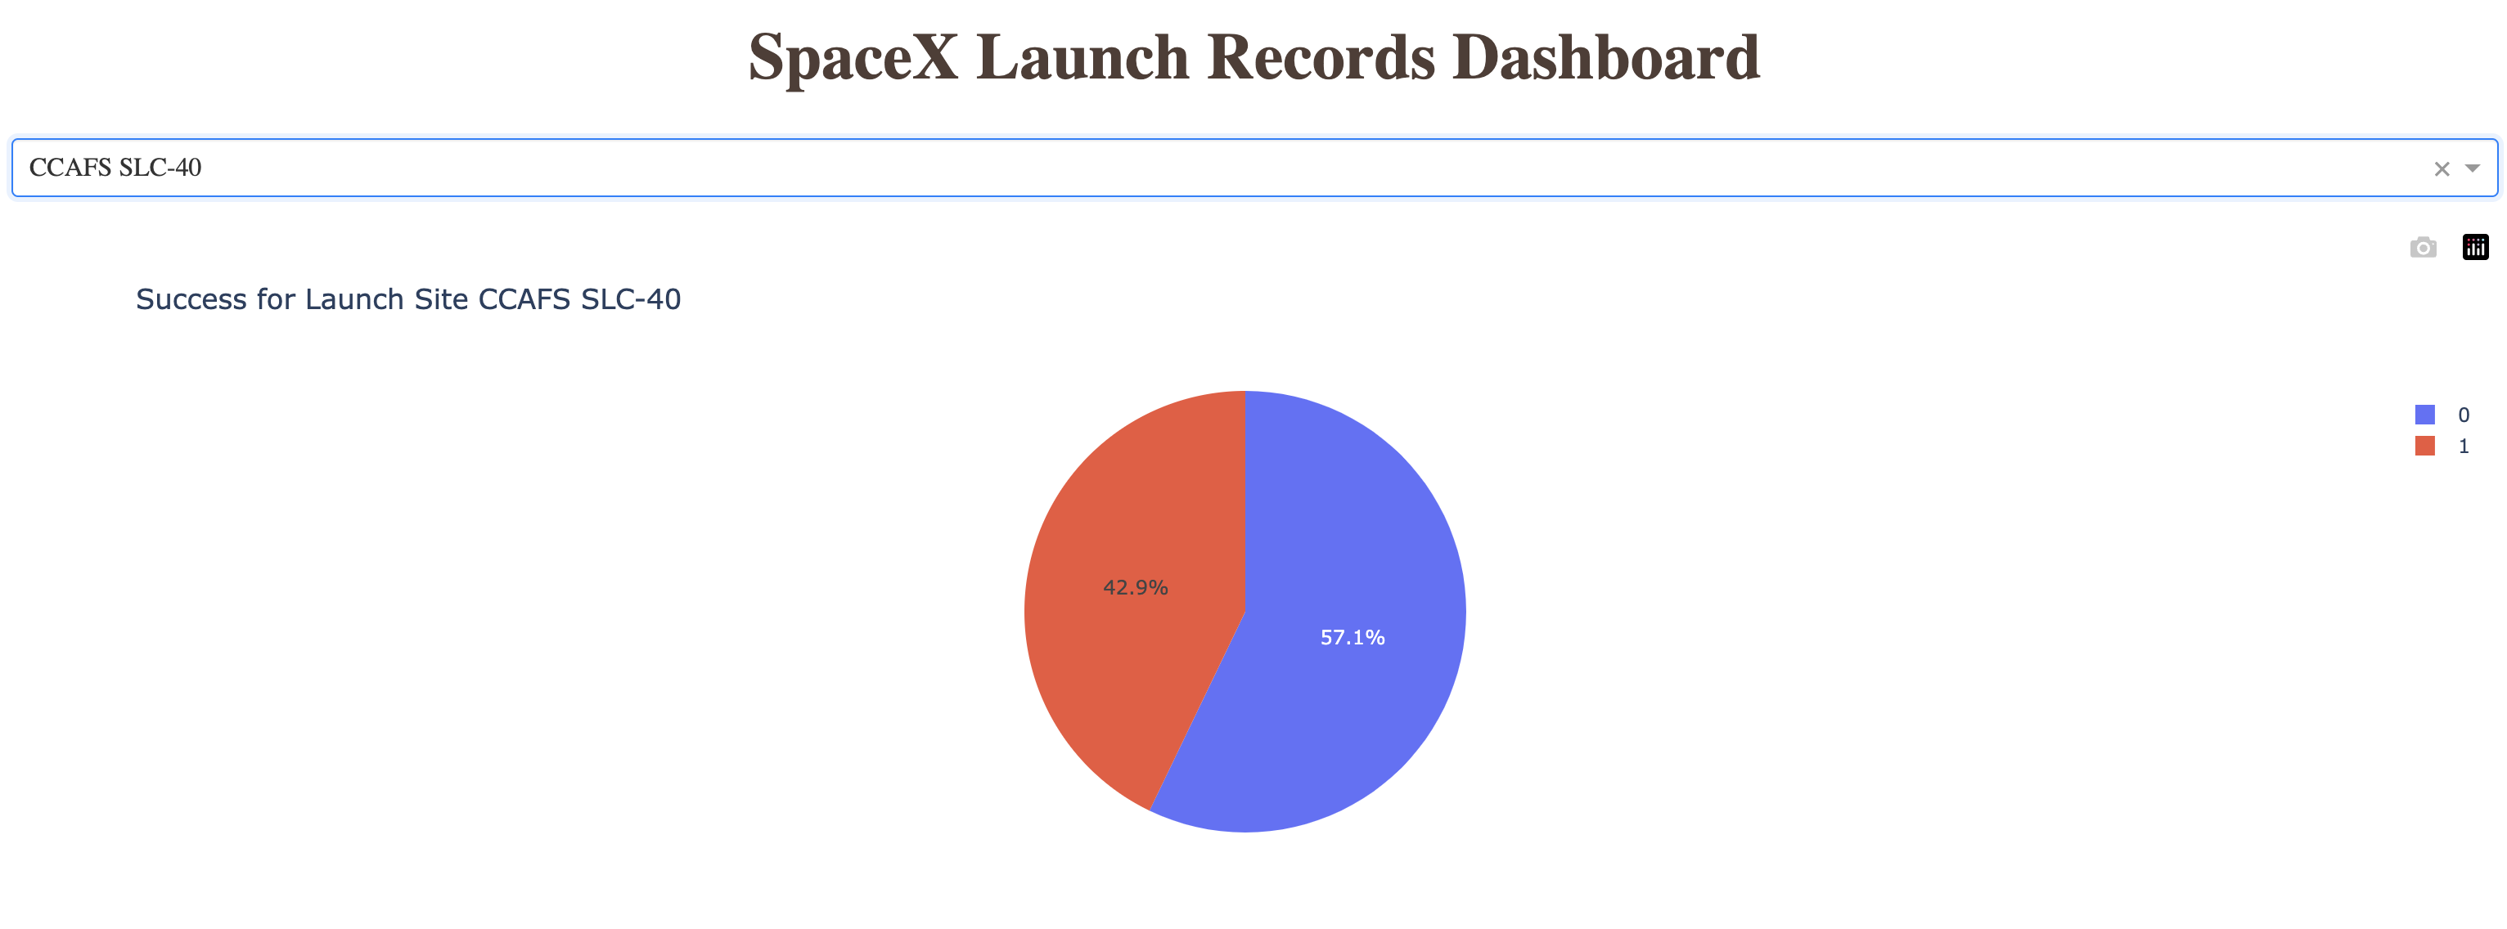
Launch Site Success Percentage
Launch site CCAFS SLC-40 is the most successful, with about 43% of launches being successful

Slide 41
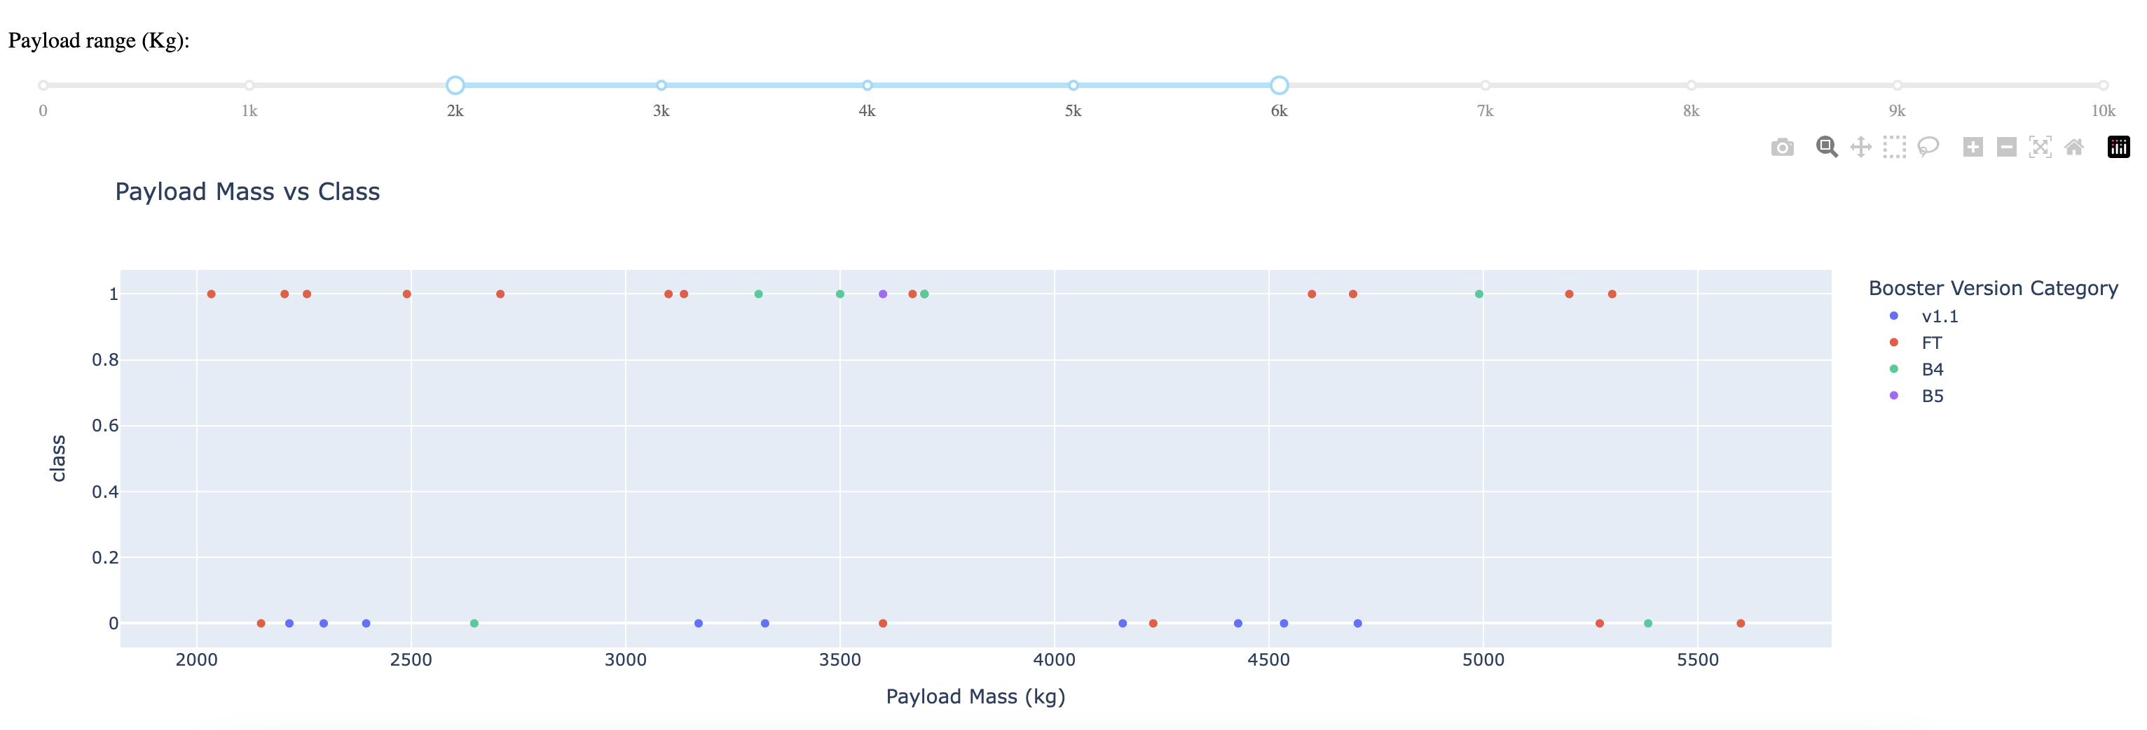
Payload Mass vs. Landing Success
Booster version FT seems to yield the most success
There looks like no clear correlation between payload mass and landing success

Slide 42

Section 5

Slide 43
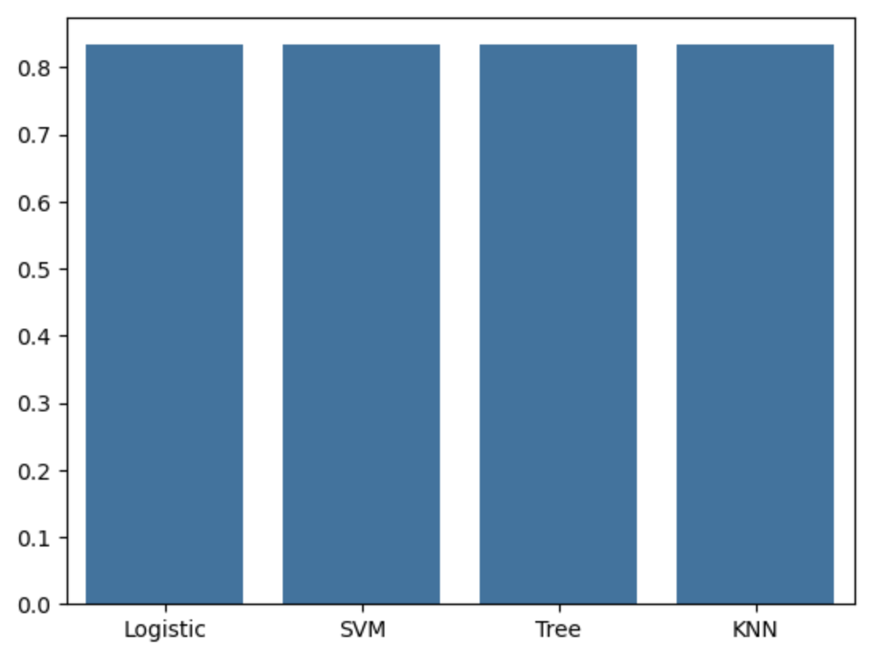
Classification Accuracy
Interestingly, all four models had the same test set accuracy of 83%
None seem to be overfit, as average training accuracy is just higher than average test accuracy (around 84%)

Slide 44
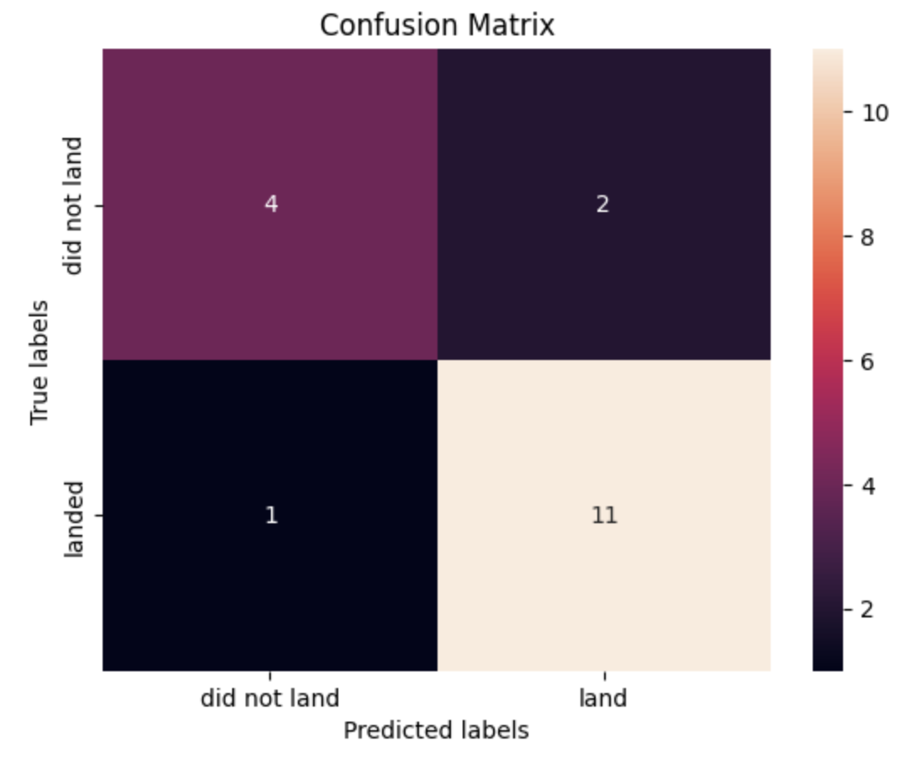
Confusion Matrix
Confusion matrix for the Decision Tree Classifier model

Slide 45
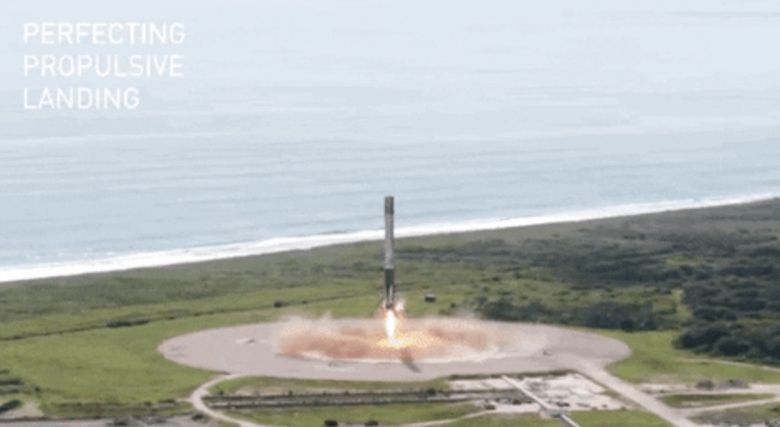
Conclusions
All models performed similarly on the task
There are likely other factors that have greater influence on landing outcome which are difficult to include in the data, such as technology development
Date might be a good proxy for this, as average landing success steadily increased over time
The curse of dimensionality is something to consider, as we have around 70 features from the encoded categorical variables alone
The accuracy is sufficient to improve cost forecasting

Slide 46


